Slide 1

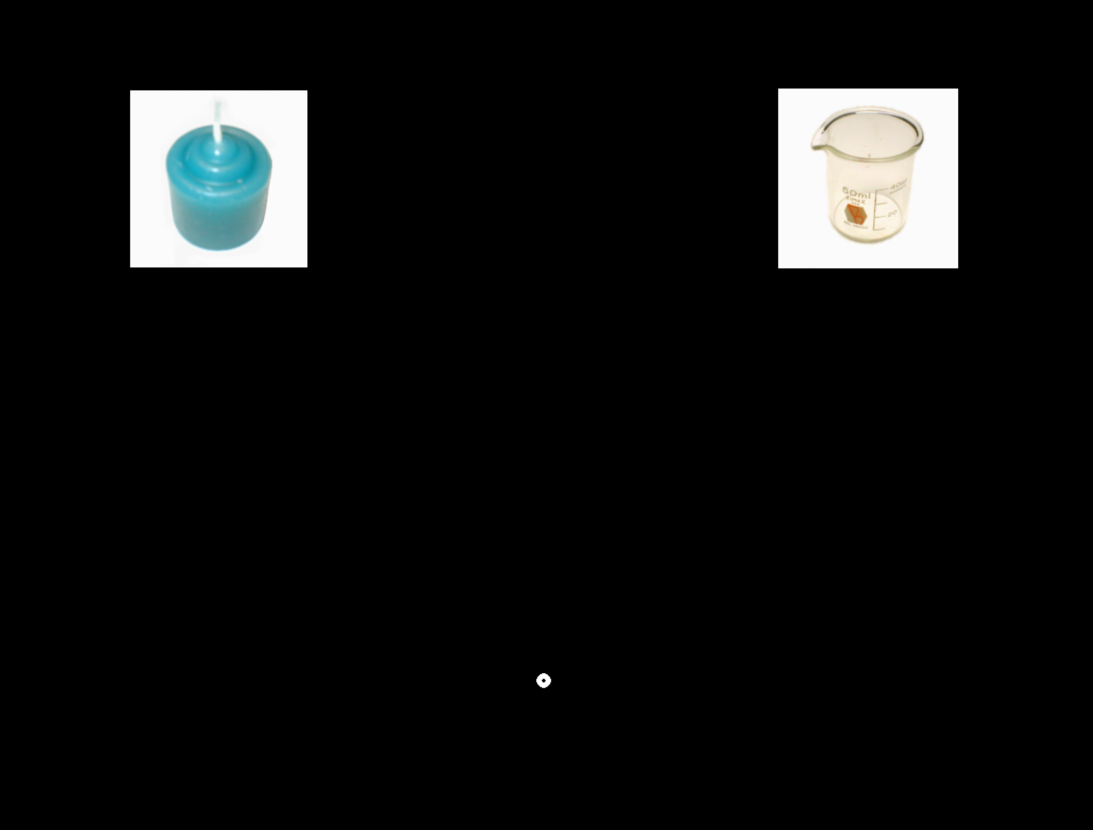

Fixation
Time : 500 ms
Auditory and visual stimuli
Time: until response given
Time
Black screen
500 ms

